Slide 1
Machine Learning
Developer Student Club JECRC

Slide 2
Classification Algorithms
K-Nearest Neighbors
Logistic Regression
Decision Trees
Adaboost
Support Vector Machine
Random Forests
Neural Networks

Slide 3
Statistical Learning Theory
Ockham Razor
The best models are simple models that fit the data well
We need balance between accuracy and simplicity
William of Ockham (1287-1347) gave the statement
“Among the hypothesis that predict equally well, we should choose the one with fewest assumptions”
Most common ML models choose their function to minimize both training error and complexity
To generalize, keep model simple as possible
Principle of Ockham’s Razor- Aim for a simple & accurate model

Slide 4
Model Complexity v/s Error

Slide 5
Steps of Machine Learning
Split Data randomly into training and test sets
Estimate coefficient / train model
Score model: Predict score for each x_{i}
Evaluate model
Evaluation example- two class classification
Label | Prediction | Category
-1 | -1 | True Negative
1 | 1 | True Positive
1 | -1 | False Negative (II)
-1 | 1 | False Positive (I)

Slide 6

Confusion Metrics
Misclassification error = (FP + FN) / n
(FP + FN) / n = (1/n) $\sum_{i=1}^{n}{1 [y !=y^{′}]}$
True Positive Rate = Sensitivity/Recall = (True Positive) / Total Positive
True Negative Rate = Specificity = True Negative / Total Negative
 | Y=1 | Y=-1
Y’ = 1 | True Positive | False Positive
Y’ = -1 | False Negative

Slide 7
Continued…
False Positive Rate = False Positive / Total Negative
Precision = True Positive / Predicted Positive
F-1 Score = 2 * (Precision * Recall) / (Precision + Recall)
Information Retrieval
Precision @N for search query: of the top N pages received, how many are relevant
Recall @N for search query: If there are N = number of relevant webpages, what fraction did our query return

Slide 8
Why?
Standard ML: Misclassification Error (Accuracy)
Doctors: TPR & TNR (Sensitivity and Specificity)
Information Retrieval: Precision Recall

Slide 9
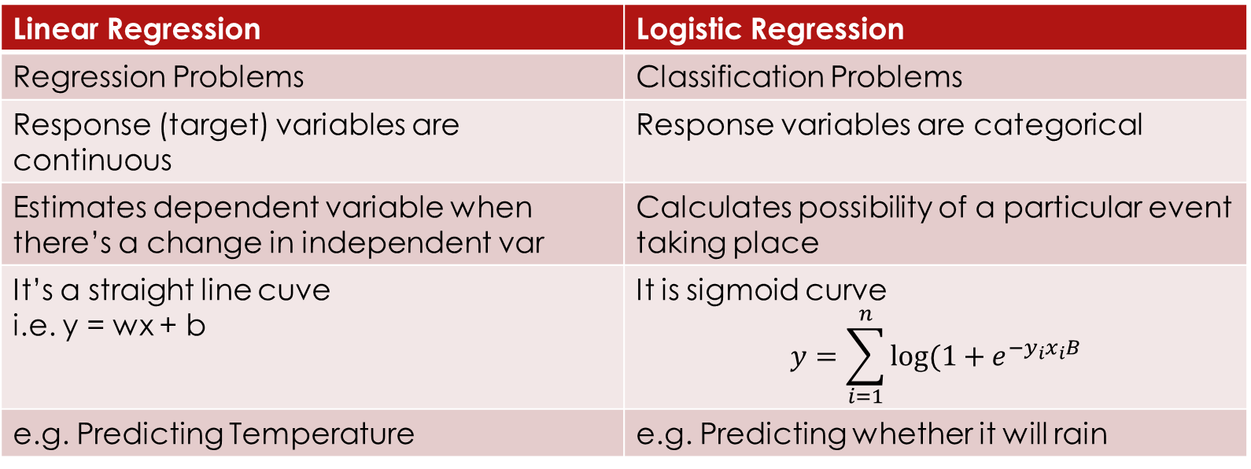
Kafi time ho gya program kha h?
Logistic Regression v/s Linear Regression
Linear Regression | Logistic Regression
Regression Problems | Classification Problems
Response (target) variables are continuous | Response variables are categorical
Estimates dependent variable when there’s a change in independent var | Calculates possibility of a particular event taking place
It’s a straight line cuve i.e. y = wx + b | It is sigmoid curve $$y=\sum_{i=1}^{n}{log⁡(1+e^{−y_{i}x_{i}B}}$$
e.g. Predicting Temperature | e.g. Predicting whether it will rain

Slide 10
Linear Regression
Y = mx + c
Y = wx + b
Karl Pearson’s Coefficient

Slide 11
Reducing Loss
Hyperparameters are configuration settings, used to tune how model is trained
Derivatives of l₂ loss for weights and biases, then take repeated steps towards minimizing the loss and this is called gradient descent
Features → Model → Prediction → Compute loss ← Targets
Tune Parameters

Slide 12
Gradient Descent
Traditional mathematics suggests to calculate gradient descent over entire dataset
Time consuming and unnecessary
Compute gradient over small dataset, just make sure to get new random data sample at each iteration
Stochastic Gradient Descent
One example at a time
Minibatch Gradient Descent
Batch size of 10 – 1000 examples
Loss and gradients are averaged at each iteration

Slide 13
TensorFlow
Not a Machine Learning Framework
General graph based computational framework
Can be used to solve any problem
Components of tensorflow
Graph Protocol Buffer
Runtime that executes the buffer
It’s a hierarchy of APIs
Each higher level of API is built on top of lower level APIs

Slide 14
TensorFlow API Hierarchy
API Name | API Type
TensorFlow Estimators (tf.estimators) | High level, Object oriented
tf.layers, tf.losses, tf.metrics | Reusable libraries for commin model components
Python tensorflow | Provides Ops which wraps C++ kernels
C++ tensorflow
GPU CPU TPU | Kernel work on platform
Flexibility (by design)
Ease of use

Slide 15
tf.estimator API
Most commonly used in ML
Compatible with SKLearn API
Pseudo Code
Import tensorflow as tf
#set linear classifier
Classifier = tf.estimator.LinearClassifier(feature_columns)
#train model
Classifier.train(input_fn = train_input, steps = 2000)
Predictions = classifier.predict(input_fn=predict_input_fn)

Slide 16




What is a Neural Network?
How do you recognize the following images-
Light sensitive cells in eyes?
Visual Cortex?

Slide 17
Write a program…
To that takes in an image and process it to identify the number in it
Comically trivial looking task becomes dauntingly difficult
Structure of a neural network
Convolutional neural network
Long short term memory

Slide 18
Neural Nets
What are the neurons
How they are connected together
A thing that holds a number
0.4

Slide 19
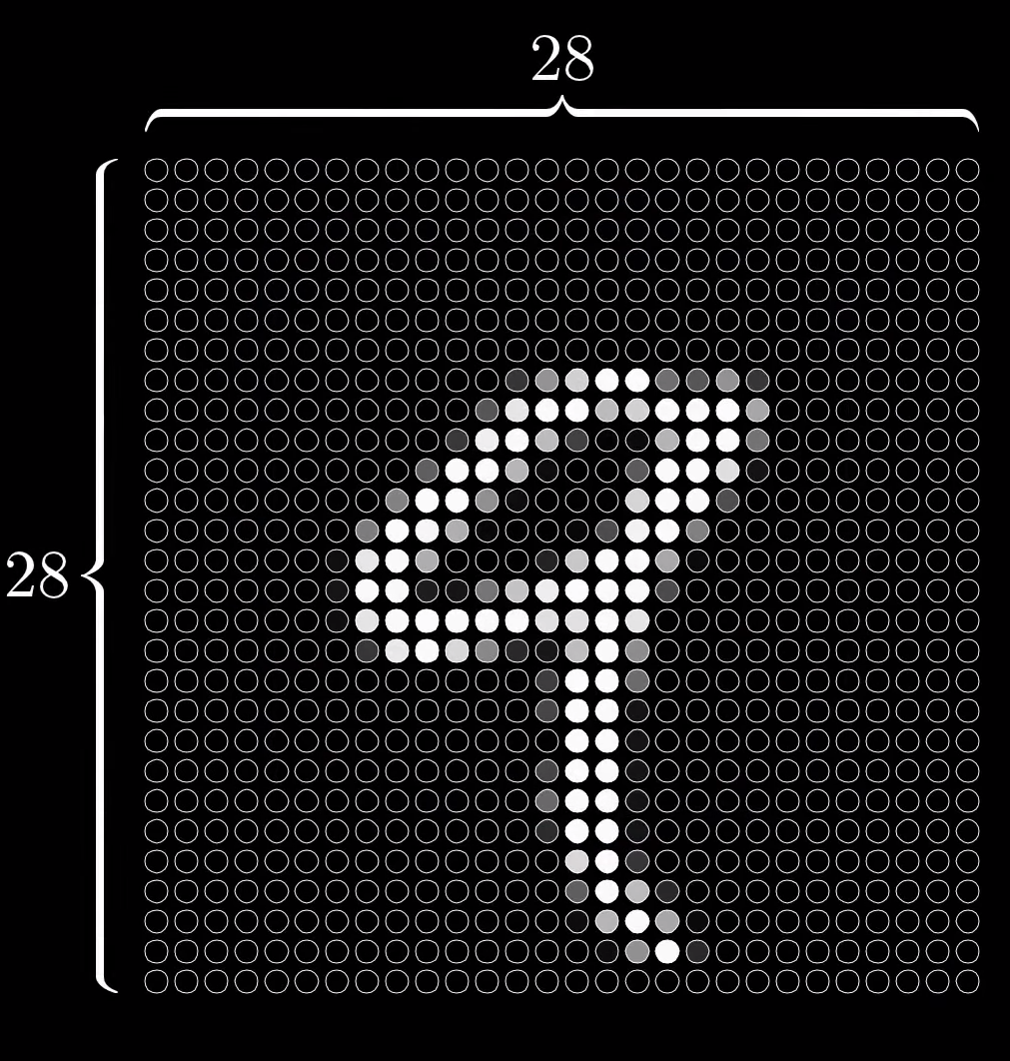
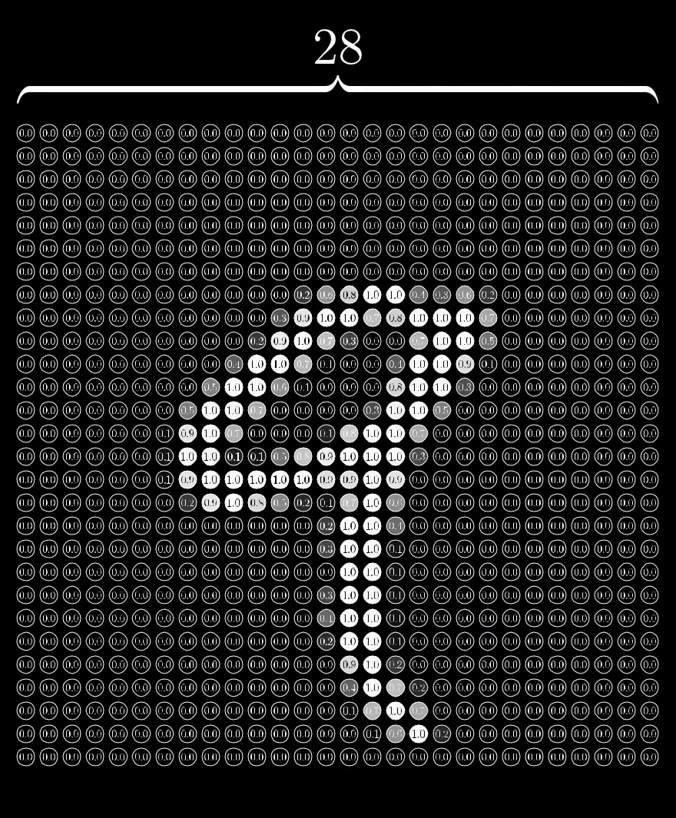

Slide 20

How a layer network is supposed to behave intelligently?
Calculate the weighted sum
W1a1 + w2a2 + w3a3 …
Squish to the range of 0 to 1
Sigmoid Function
$σ(x)=1/(1+e^{−x})$

Slide 21
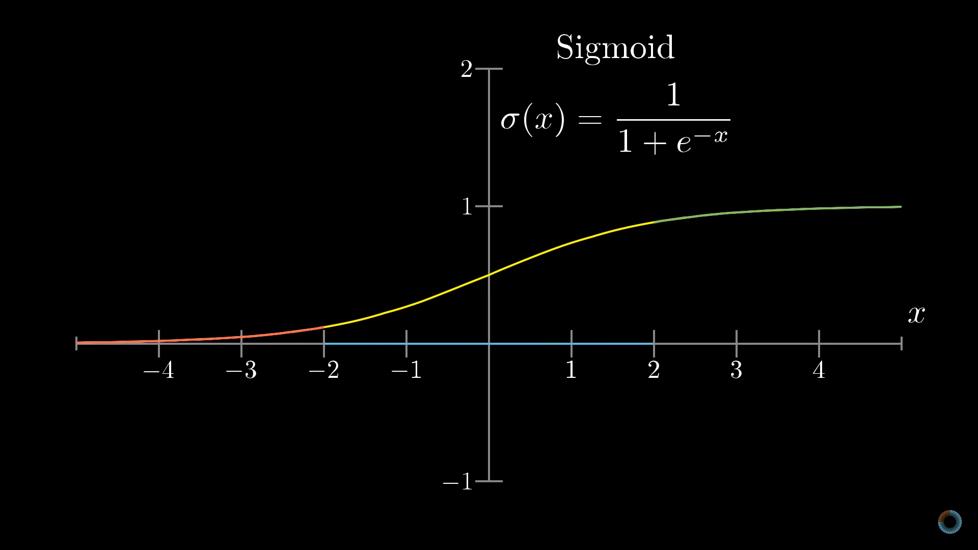

Slide 22

Bias for activation
$σ$(W1a1+w2a2+w3a3+ … - bias)
784 * 16 weights + 16 biases
16*16 weights + 16 * 10
A total of 13002 weights and biases

